Slide 1
Final Project
Ruolan Liu
Natthiya Sae Ngow
CS4375.501

Slide 2
Datasets We Choose
Lifestyle Factors and Their Impact on Students
AI Generated Ghibli Style Image Trends (2025)
Average Daily Screen Time for Children
Cost of International Education

Slide 3
Lifestyle Factors and Their Impact on Students:
This dataset provides students’ lifestyle patterns and their correlation with academic performance, which is represented by GPA. It contains 2000 records of students’ daily habits including study, extracurriculars, sleep, etc. Each student’s stress level is according to the study and the sleep time of each student. This dataset provides a deep understanding of how lifestyle affects academic outcomes. (Description adapted from the dataset source)

Slide 4
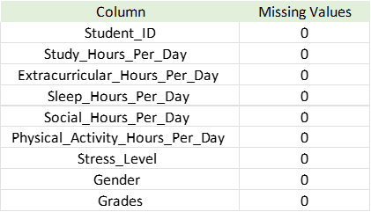


Data Quality and Category Distributions
The dataset contains 2000 entries and 9 columns including both numeric and categorical variables.
There are no missing values or duplicate values.

Slide 5
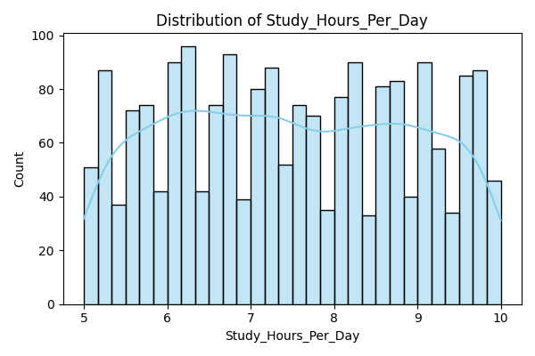
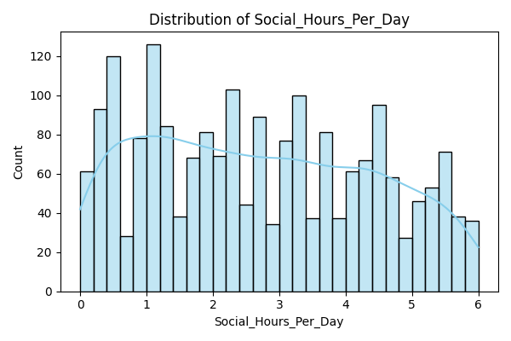
Numeric Features - Distribution 1

Slide 6
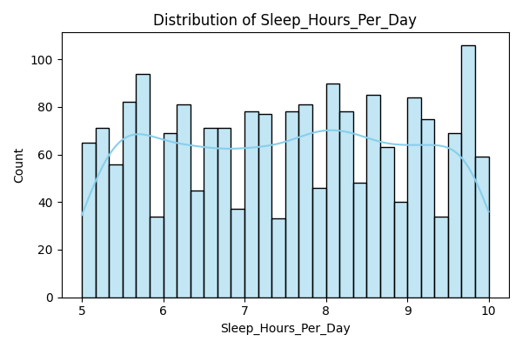
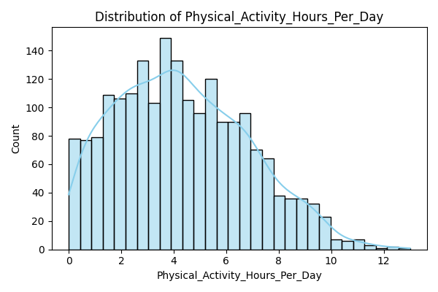
Numeric Features - Distribution 2

Slide 7
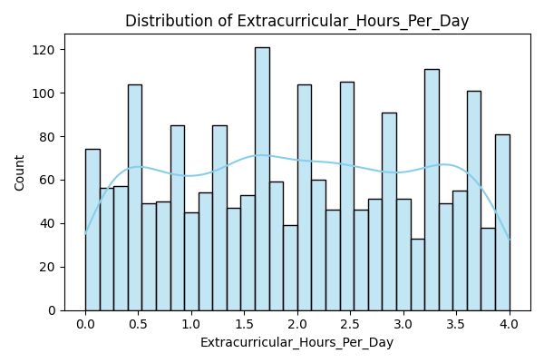
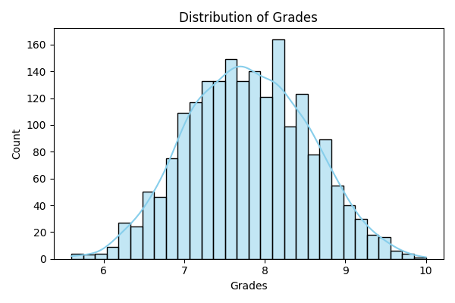
Numeric Features - Distribution 3

Slide 8
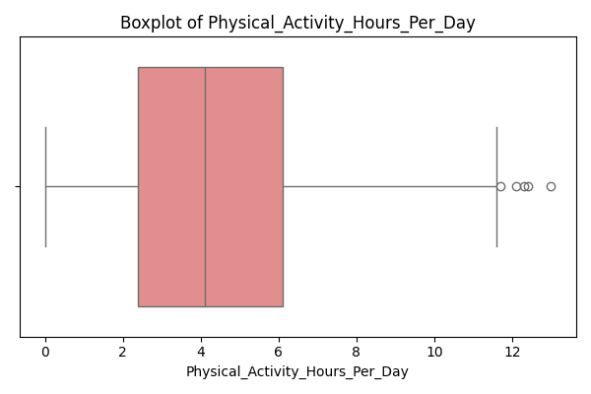
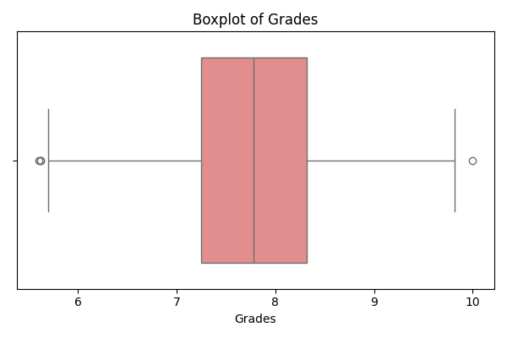
Outlier Detection

Slide 9
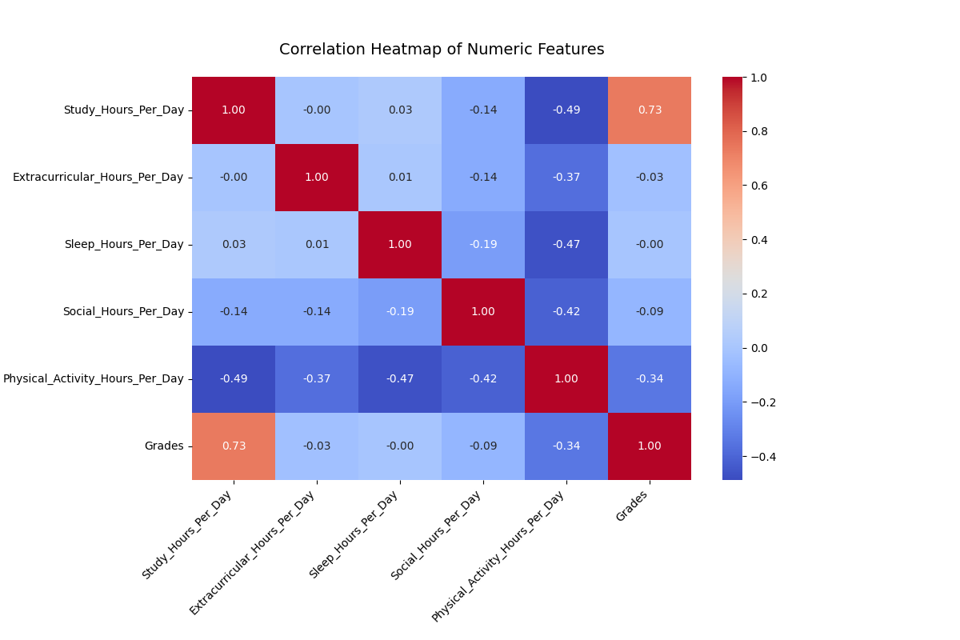
Correlation Analysis

Slide 10
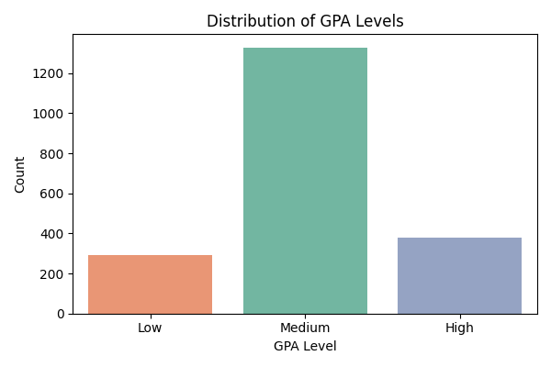
Target Label Creation (GPA Level)
We converted the GPA scores into 3 classes:
Grades < 7.0 → “Low”
7.0 ≤ Grades < 8.5 → “Medium”
Grades ≥ 8.5 → “High”

Slide 11
Feature Engineering and Modeling
We encoded categorical features (Gender, Stress Level, GPA Level) and standardized numeric features by using Z-score normalization.
Models:
Logistic Regression
Decision Tree
Random Forest
KNN
The data was split into 80% training and 20% testing.

Slide 12
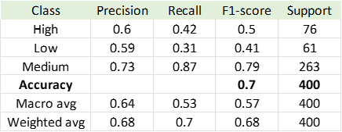
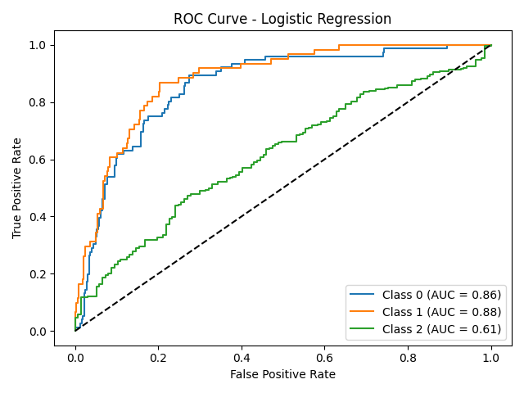
Model Performance 1
Logistic Regressions:
Accuracy: 0.7
strong performance in Medium Class (Recall 0.87)
struggled with Low Class (Recall 0.31)
ROC AUC for Class 0 and 1 are better than Class 2
(Class0 = High; Class1=Low; Class2=Medium)

Slide 13
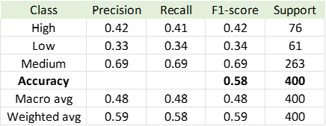
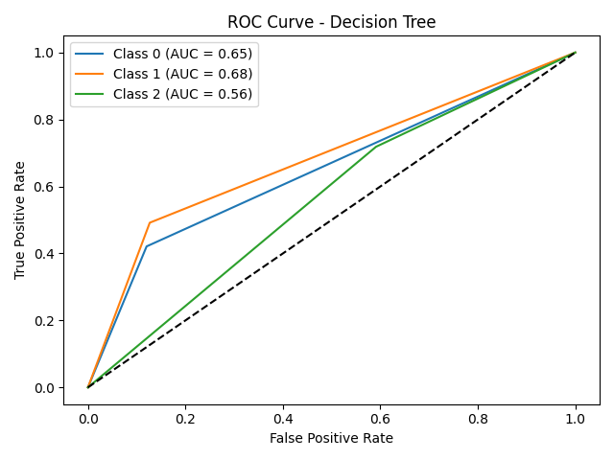
Model Performance 2
Decision Tree:
Accuracy: 0.58
best performance on Medium Class (Recall 0.69)
weak performances on both High and Low Class
ROC AUC is lower than Logistic Regression one

Slide 14

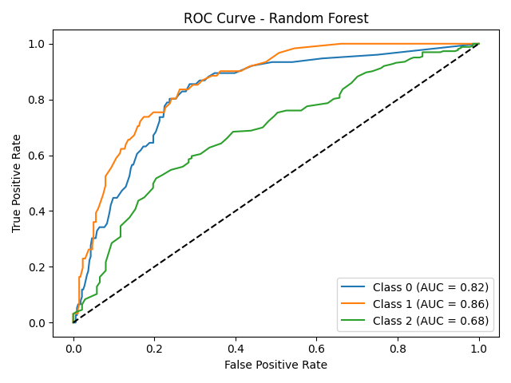
Model Performance 3
Random Forest
Accuracy: 0.69
high recall on Medium Class (0.86)
moderate performance on Low and High Class

Slide 15

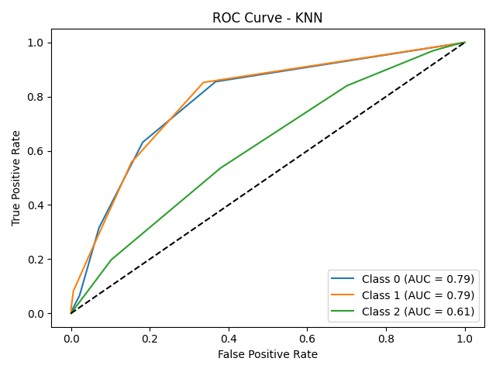
Model Performance 4
KNN
Accuracy: 0.65
high recall on Medium Class (0.84)
low recall on Low Class (0.26)

Slide 16

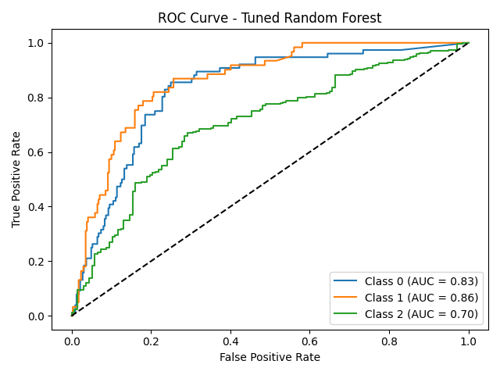
Model Performance 5
Tuned Random Forest:
Accuracy: 0.6825
slightly lower than the default one and the logistic regression one
didn’t improve the performance

Slide 17
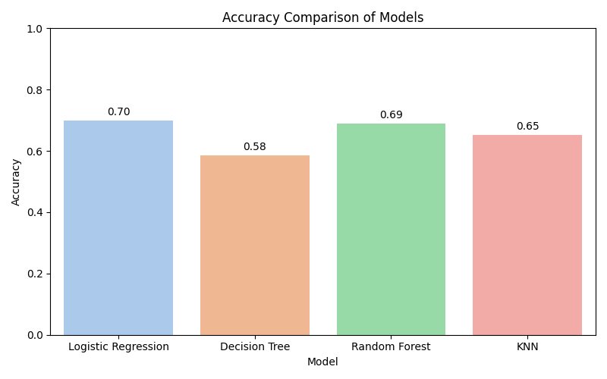
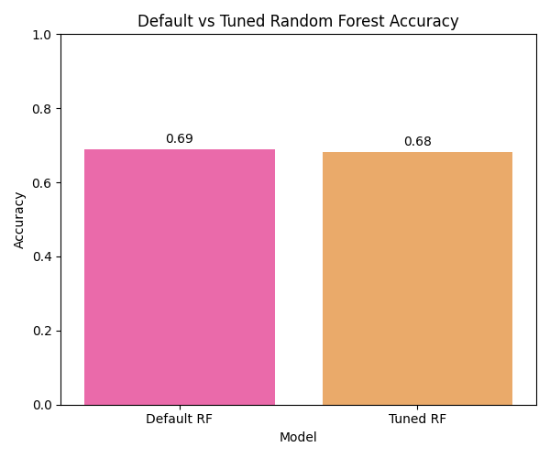
Comparison

Slide 18
Conclusion
In conclusion, the Logistic Regression has the highest accuracy and strong performance on identifying students with Medium GPA.
Compare to other models, Logistic Regression is the most suitable model for this dataset.
Both Logistic Regression and Random Forest gave us useful interpretability.
Logistic Regression showed that Study Hours strongly contributed to GPA prediction.
Random Forest confirmed that Study Hours, Stress Level, and Physical Activity were the top features.

Slide 19
AI Generated Ghibli Style Image Trends (2025)
This dataset collects the trends in AI-generated Studio Ghibli-style images including user engagement, generation metrics, and platform-specific interactions.
500 records and 16 features.

Slide 20
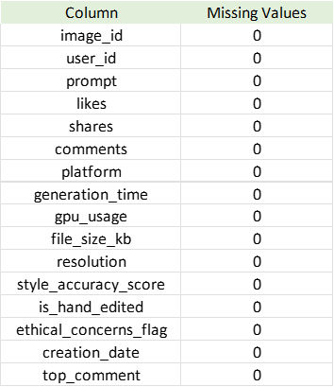
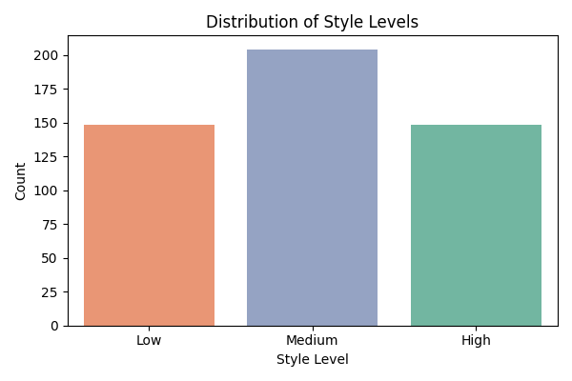
Data Preprocessing & Distributions
No missing or duplicated values
Most features are approximately uniformly distributed.
Target variable: style level (Low, Medium, High)
style_accuracy_score < 65 → “Low”
65 ≤ style_accuracy_score < 85 → “Medium”
style_accuracy_score ≥ 85 → “High”

Slide 21
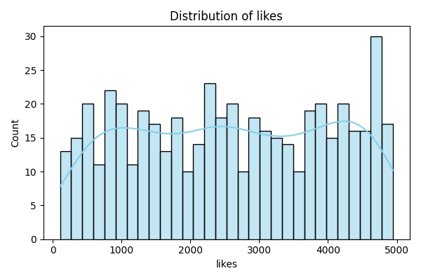
Boxplots & KDE Histograms
Boxplots show clean distributions with no extreme outliers.
KDE histograms indicate near-uniform distribution for most numeric variables.
Some spikes are shown near boundaries
e.g. likes near 5000

Slide 22
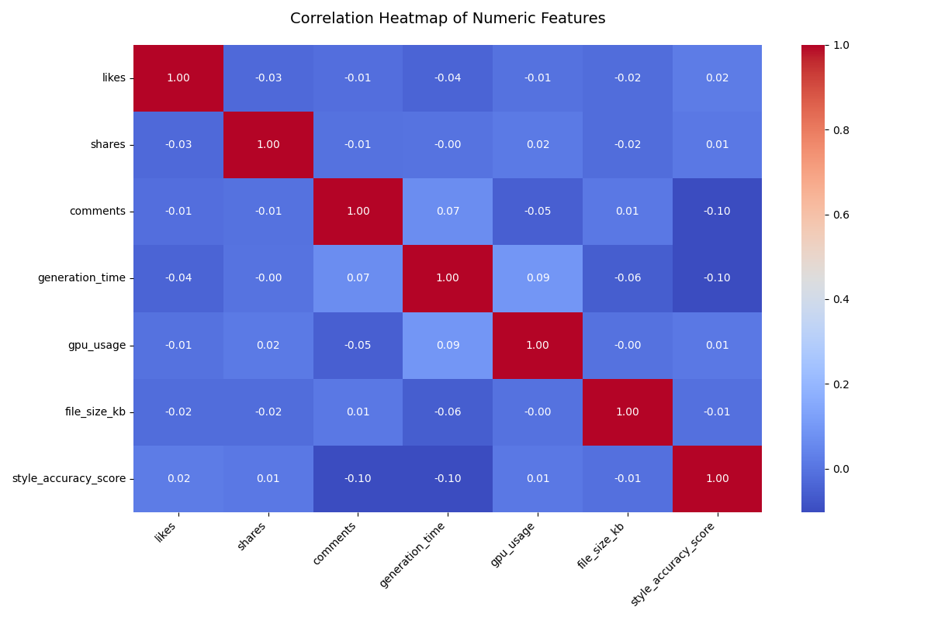
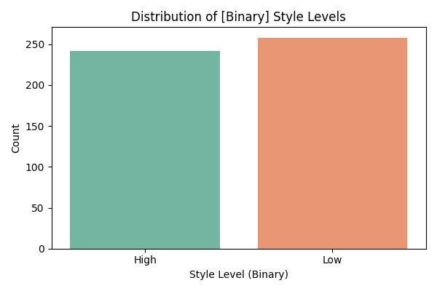
Correlation & Feature Engineering
Correlation values are weak among variables.
Created target variables:
Style_Level (multi-class)
Style_Binary (High vs Low)

Slide 23
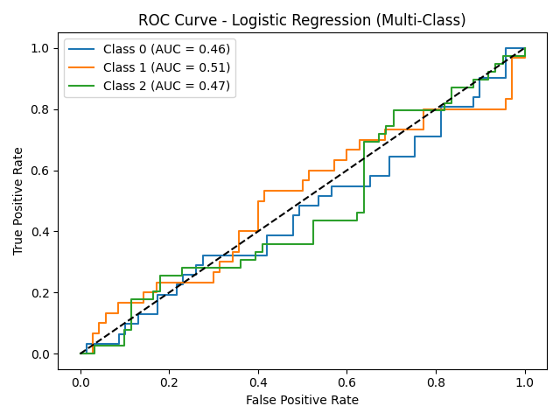
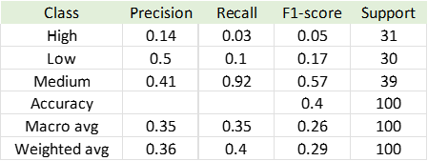
Multi-Class Performances 1
Logistic Regression (Multi)

Slide 24
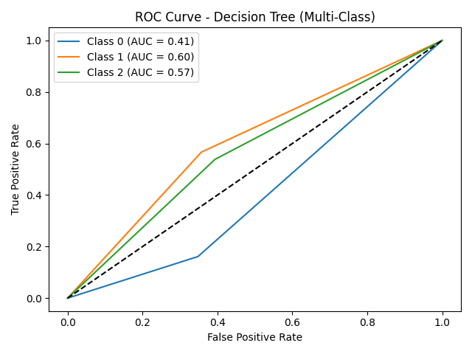
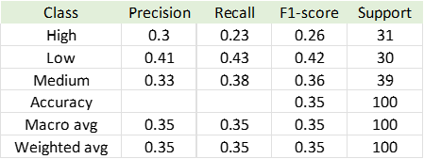
Multi-Class Performances 2
Decision Tree (Multi)

Slide 25
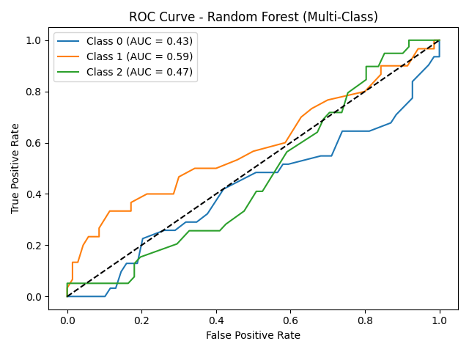
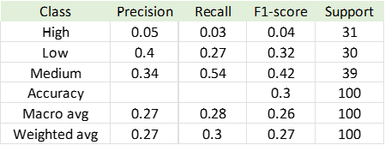
Multi-Class Performances 3
Random Forest (Multi)

Slide 26
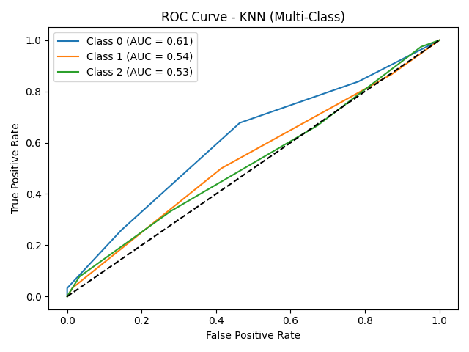

Multi-Class Performances 4
KNN (Multi)

Slide 27
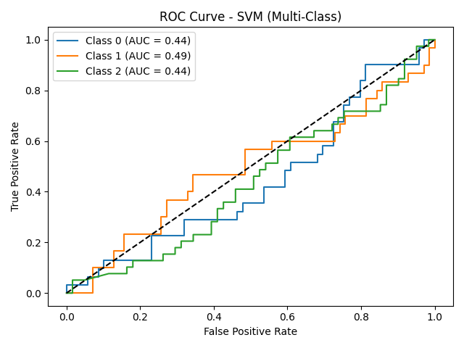

Multi-Class Performances 5
SVM (Multi)

Slide 28
Why Multi-Class Performances Badly?
The main issue was class imbalance, especially the Medium class is underrepresented.
This made it hard for models to distinguish boundaries effectively.
Also, the numerical features didn’t show strong separability among the three classes.
After we simplified the task to binary classification (High vs Low), the model performance improved significantly.

Slide 29
Multi-Class Classification Summary
Overall accuracy was low across all models.
SVM had the best multi-class accuracy: 0.43
but it has low AUC values

Slide 30
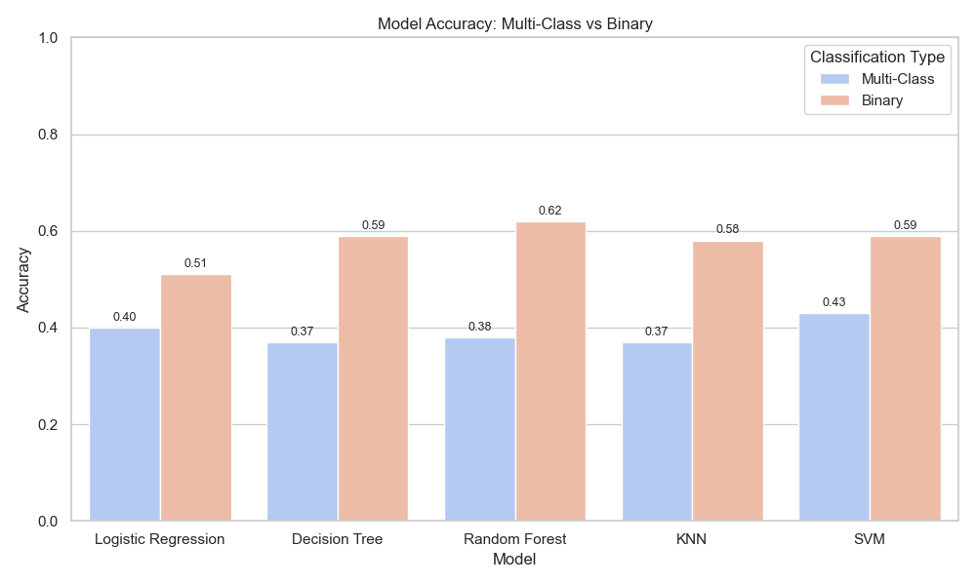
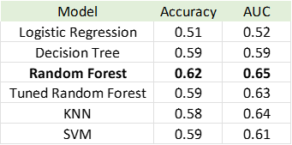
Binary Classification
We simplified the task to binary classification (High vs Low)
This change improved model performance significantly.

Slide 31
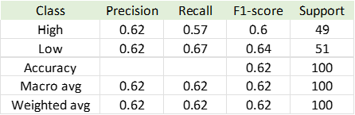
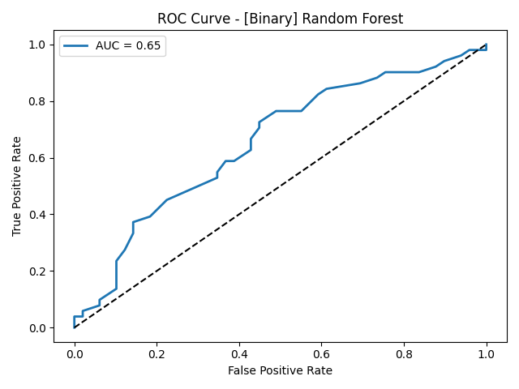
[Binary] Random Forest Performing (Default)
Accuracy: 0.62
AUC: 0.65
Balanced precision and recall

Slide 32
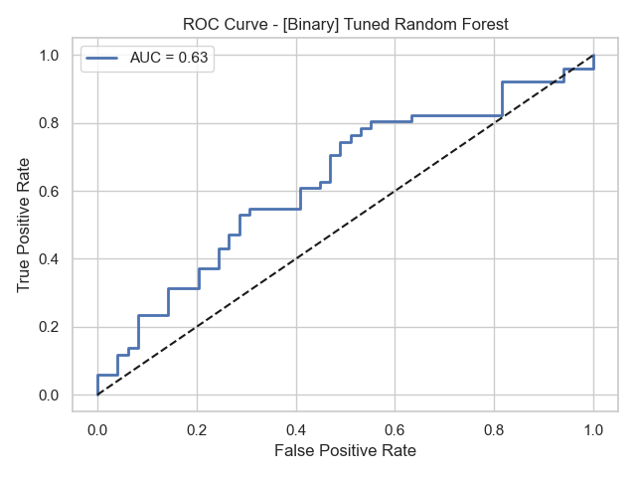
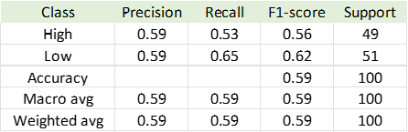
[Binary] Random Forest Performing (Tuned)
Accuracy: 0.59
AUC: 0.63
got lower accuracy and AUC compared to the default one

Slide 33
Conclusion
Multi-class Classification results were weak
Binary classification improved performance
The best model is Random Forest (Binary, Default)
It also provides a certain level of interpretability.
It allows us to examine feature importances.
The most influential features in predicting style level ewre likes, shares, manual edit status and style accuracy score.

Slide 34
Average Daily Screen Time for Children
This dataset contains 198 observations and 6 variables. It captures real-world patterns in children’s screen time usage across ages 5 to 15, including educational, recreational, and total screen time. Variables also account for gender (Male, Female, Other/Prefer not to say) and day type (Weekday, Weekend). The data reflects trends such as increasing screen time with age, higher usage on weekends, dominance of recreational screen time, and slight gender difference. Sample size varies by age, from 500 responses at age 5 down to 300 at age 15, adding to the dataset’s realism.

Slide 35
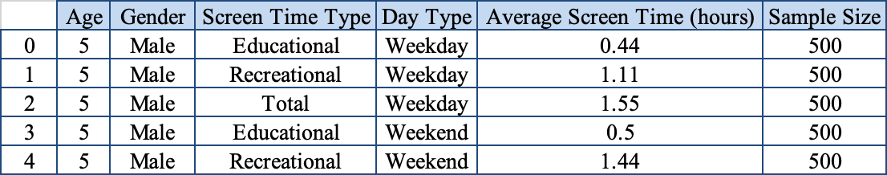
Average Daily Screen Time for Children
Data shape :(198, 6)
3 Categorical variables in the dataset : Gender, Screen Time Type, and Day Type
3 Numerical variables : Age, Average Screen Time(hours), and Sample Size)
The target variable : High Screen Time
The data no missing values and duplicate entries.
Dataset Head

Slide 36
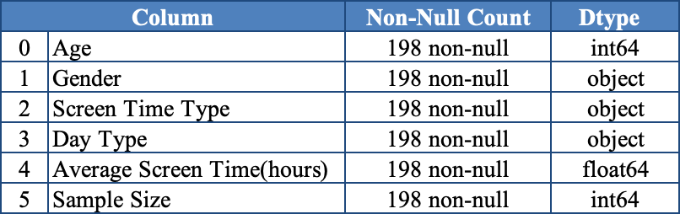
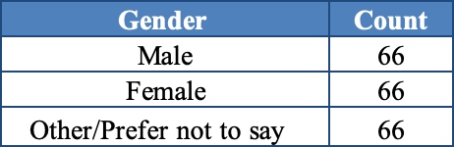
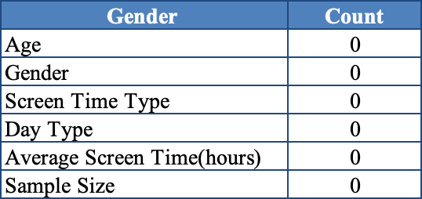
Average Daily Screen Time for Children
Missing Value

Slide 37
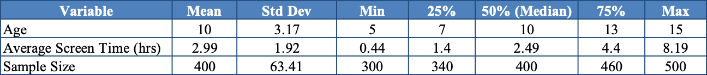
Average Daily Screen Time for Children
Descriptive Statistics and Distribution:
This table shows that Age is distributed from 5 (Min) to 15 (Max) with a mean and median of 10 that confirms a symmetrical age range. Average Screen Time shows a wide range from 0.44 (Min) to 8.19 (Max) hours with median 2.49 slightly below the mean 2.99, indicating a slight right skewed distribution. In addition, Sample Size decreases with age that more young participants, which aligns with realistic sampling in child studies.

Slide 38
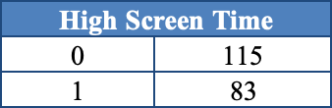
Average Daily Screen Time for Children
Data Preparation and Encoding
We examined the distribution of the target variable : High Screen Time, using a class balance check. This variable was derived by comparing each row’s average screen time to a 3-hour threshold, resulting in two binary classes:
0 = Children with screen time ≤ 3 hours → "Low Screen Time"
1 = Children with screen time > 3 hours → "High Screen Time"
The output shows that 115 entries fall into the low screen time group (class 0), while 83 entries are classified as high screen time (class 1). This distribution indicates a slight class imbalance but remains suitable for binary classification tasks.)
Class Balance:

Slide 39
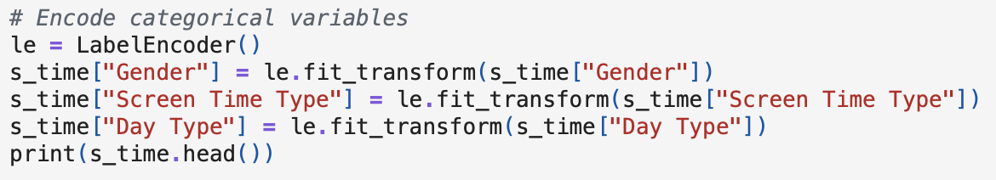
Average Daily Screen Time for Children
Label Encoding of Categorical Variable and Prepare training data
We convert categorical features : Gender, Screen Time Type and Day Type into numeric value by using LabelEncoder().
To prepare the training data set x as defined as the input features for model training , while y was set as a target label ( High Screen Time). The drop column Average Screen Time (hours) is excluded to prevent target leakage, since it's directly related to the label being predicted.

Slide 40
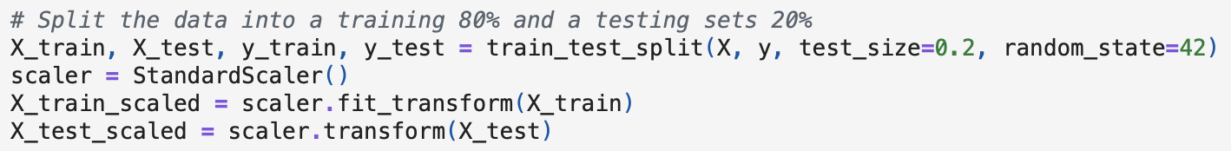
Average Daily Screen Time for Children
Experiments and Learning the Models
Train Test Split and Feature Scaling with StandardScaler : The dataset is split into 80% for training the model (X_train, y_train) and 20% for testing its performance (X_test, y_test), with random_state=42

Slide 41
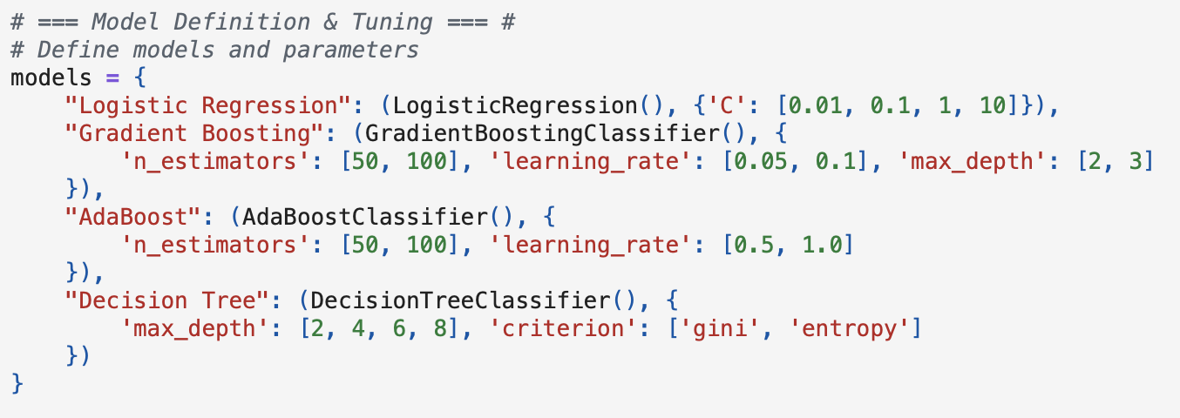
Average Daily Screen Time for Children
2. Model Definition, Grid Tuning, and Evaluation
We defined four machine learning models : Logistic Regression, Gradient Boosting, AdaBoost, and Decision Tree, and each paired with a grid of hyperparameter values for tuning. To keep the process efficient, the grid size was kept small to medium.

Slide 42
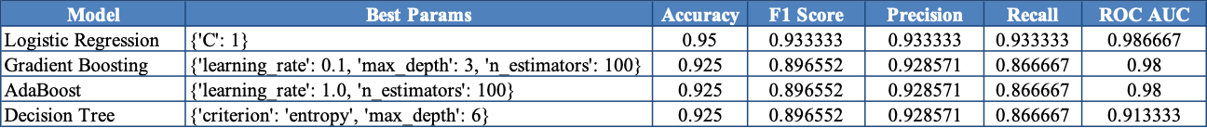
Average Daily Screen Time for Children
Model Performance Results
Hyperparameter tuning was performed using GridSearchCV with 5-fold cross-validation and evaluated using Accuracy, F1 Score, Precision, Recall, and ROC AUC, enabling optimization of each model’s key parameters. The final performance metrics are summarized in the table below.

Slide 43
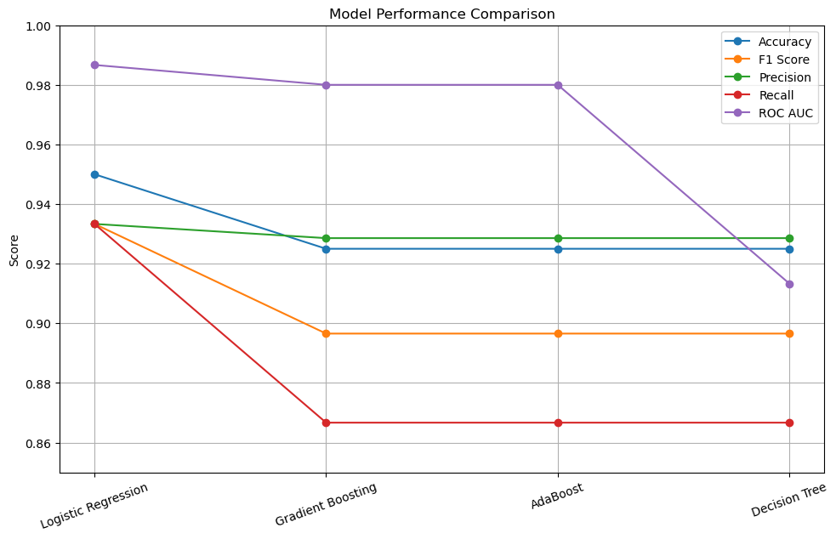
Average Daily Screen Time for Children
Logistic Regression is the best performing model overall.
Accuracy of 95%,
F1 Score of 93.33%,
Precision of 93.33%,
Recall of 93.33%
ROC AUC of 98.67%.
Its high AUC indicates excellent classification capability across probability thresholds.

Slide 44

Average Daily Screen Time for Children
Feature importance
Performed by fitting 4 trained machine learning models Logistic Regression, Gradient Boosting, AdaBoost, and Decision Tree with the best-known hyperparameters. Each model is trained using the option found through GridSearchCV.

Slide 45

Average Daily Screen Time for Children
Feature Importance
To compare which features were most influential in each model, a feature importance table was created using a pandas DataFrame (importance_df). This table includes the feature names, coefficients from Logistic Regression, and feature importance scores from Gradient Boosting, AdaBoost, and Decision Tree models. Feature importance was extracted using:
log_reg.coef_[0] for Logistic Regression
.feature_importances_ for tree-based models (Gradient Boosting, AdaBoost, Decision Tree)

Slide 46


Average Daily Screen Time for Children
Feature Importance Results
The Logistic Regression Model identified the most influential features as
Screen Time Type (+3.17)
Sample Size (–1.50)
Age (+1.50)
This indicates that Screen Time Type has the strongest positive association with high screen time.

Slide 47
Average Daily Screen Time for Children
Conclusion
The dataset reveals screen time behavior that aligns with expected patterns related to Age usage
The Logistic Regression Model achieved the highest overall performance with the best balance of accuracy and interpretability with Accuracy of 95%, F1 Score of 93.33%, Precision of 93.33%, Recall of 93.33%, ROC AUC of 98.67%.
Screen Time Type is the most influential predictor across all models.

Slide 48
Cost of International Education
This dataset contains 907 observations and 12 variables, compiled detailed financial information for students pursuing higher education abroad. It spans multiple countries, cities and universities around the world, capturing a comprehensive spectrum of tuition fees, living expenses and key ancillary costs.
Standardized fields include tuition in USD, living cost indices, rent, visa fees, insurance, and up-to-date exchange rates. Currency values were derived based on local currency units per U.S dollar at the time of data collection.

Slide 49

Cost of International Education
Data shape :(907, 12)
5 Categorical variables in the dataset : Country, City, University, Program and Level
7 Numerical variables : ADuration_Year, Tuition_USD, Living_Cost_Index, Rent_USD, Visa_Fee_USD, Insurance_USD and Exchange_Rate)
The target variable : High Cost
Dataset Head

Slide 50



Cost of International Education
The data no missing values and duplicate entries.
Missing Value
Dataset Variables
Dataset Info

Slide 51

Cost of International Education
Descriptive Statistics and Distribution
5 Categorical Variables:
(Country, City, University, Program and Level):
A wide global representation across 71 Countries , 556 Cities, 622 Universities, 92 Program and 3 Levels. The most popular program is Computer Science and the majority of entries are the Master’s level programs.

Slide 52

Cost of International Education
Descriptive Statistics and Distribution
7 Numericals Variables :
(Duration_Year, Tuition_USD, Living_Cost_Index, Rent_USD, Visa_Fee_USD, Insurance_USD and Exchange_Rate)
The average program duration is approximately 3 years. Tuition fees range from $0 (likely in public universities with full subsidies) to $62,000, with a mean of around $16,700, indicating a heavily skewed distribution. Living costs also vary significantly which monthly rent ranges from $150 to $2,500, reflecting the diversity of global housing markets. The Living Cost Index peaks at 122.4, likely corresponding to high-cost cities.

Slide 53

Cost of International Education
Data Preparation and Encoding
We created two engineered variables: Total_Cost_USD and HighCost.
The Total_Cost_USD feature was calculated to represent the estimated total cost of attending a program, including both tuition and living expenses. The HighCost feature is a binary classification label indicating whether a program is considered high-cost or not.

Slide 54

Cost of International Education
Class Balance Check
We examined the distribution of the target variable : High Cost , using a class balance check to label in two binary classes:
0 = a program with total cost ≤ the median → "Low total cost"
1 = a program with total cost > the median → "High total cost"
The output shows that 454 entries fall into the low total cost group (class 0), while 453 entries are classified as high total cost (class 1). This distribution indicates a class perfect balance for binary classification tasks.
Class Balance:

Slide 55

Cost of International Education
Standard Scale of Numerical Variables and One-hot Encoding of Categorical Variable and Prepare training data
We separated numerical variables : Duration_Year, Tuition_USD, Living_Cost_Index, Rent_USD, Visa_Fee_USD, Insurance_USD and Exchange_Rate by scaled using method StandardScaler(), applies Z-score normalization (mean = 0, std =1)

Slide 56

Cost of International Education
Standard Scale of Numerical Variables and One-hot Encoding of Categorical Variable and Prepare training data
We convert categorical variables : Country, City, University, Program and Level) into binary dummy variables using one-hot encoding.

Slide 57
Cost of International Education
Experiments and Learning the Models
Train Test Split and Feature Scaling with StandardScaler : The dataset is split into 80% for training the model (X_train, y_train) and 20% for testing its performance (X_test, y_test), with random_state=42

Slide 58

Cost of International Education
Model Definition, Tuning, and Evaluation
We defined four machine learning models : Logistic Regression, Random Forest, Support Vector Machine (SVM) and Gradient Boosting, and each paired with a grid of hyperparameter values for tuning. To keep the process efficient, the grid size was kept small to medium.

Slide 59

Cost of International Education
Model Performance Results
Hyperparameter tuning was performed using GridSearchCV with 5-fold cross-validation and evaluated using Accuracy, F1 Score, Precision, Recall, and ROC AUC, enabling optimization of each model’s key parameters. The final performance metrics are summarized in the table below.
Final Model Performance Results

Slide 60

Cost of International Education
The Logistic Regression Model is the best-performing model overall.
Accuracy of 98.35%
Achieving the highest ROC AUC of 99.89%,
well-balanced precision, recall, and F1 score of 98.35%.
Its high AUC indicates excellent classification capability across probability thresholds.

Slide 61

Cost of International Education
Feature importance
Performed by fitting 4 trained machine learning models Logistic Regression, Random Forest , SVC and Gradient Boosting with the best-known hyperparameters. Each model is trained using the option found through GridSearchCV.

Slide 62

Cost of International Education
Feature importance
To compare which features were most influential in each model, a feature importance table was created using a pandas DataFrame (importance_df). This table includes the feature names, coefficients from Logistic Regression and SVM and feature importance scores from Random Forest and Gradient Boosting models. Feature importance was extracted using:
log_reg.coef_[0] for Logistic Regression
svm.coef_[0] for SVM
feature_importances_ for tree-based models (Random Forest and Gradient Boosting)

Slide 63

Cost of International Education
Feature imporotance Results : Top 10 Features by Importance for Each Model
1. Logistic Regression Model
Logistic Regression identified the most influential features as ;
Tuition_USD (6.8648)
Rent_USD(5.8316), and
Duration_Years (2.8699)
Tuition and Rent are the primary drivers, with university and program indicators significantly influencing the linear decision boundary

Slide 64

Cost of International Education
Feature imporotance Results : Top 10 Features by Importance for Each Model
2. Random Forest Model
The Random Forest model identified the most influential features as ;
Tuition_USD (0.1504)
Insurance_USD (0.1165), and
Living_Cost_Index (0.1071)
This model captures a broader range of cost-related influences, highlighting the significance of various financial factors beyond just Tuition and Rent.

Slide 65

Cost of International Education
Feature imporotance Results : Top 10 Features by Importance for Each Model
3. SVM
The SVM model identified the most influential features as :
Tuition_USD (2.1589),
Rent_USD(1.8505), and
Duration_Years (0.8382)
Country-specific factors such as Country_Canada and Country_UAE, along with program and university indicators, also had an important impact.

Slide 66

Cost of International Education
Feature imporotance Results : Top 10 Features by Importance for Each Model
4. Gradient Boosting
The Gradient Boosting model identified the most influential features as :
Tuition_USD (0.7165), and
Rent_USD (0.1466)
Other relevant but weaker contributors include Duration_Years, Level_Master, and Exchange_Rate.

Slide 67

Cost of International Education
Feature imporotance Results : Top 10 Features by Importance for Each Model
The heatmap shows that
Tuition_USD (6.86) , and
Rent_USD (5.83) are the most important features across all models , particularly in the Logistic Regression model
Logistic Regression and SVM assign positive or negative weights to categorical indicators, such as University_University of Amsterdam (−1.922) and Level_Master (−1.90)
Random Forest and Gradient Boosting assign minimal or zero weight to binary university and country indicators

Slide 68
Cost of International Education
Conclusion
The dataset reveals that the total cost of international education is primarily driven by tuition fees and rent, with the living cost index and program duration serving as secondary contributors.
Logistic Regression and Gradient Boosting emerged as the top performers, each achieving an accuracy and F1 score of 98.35%, with ROC AUCs of 99.89% and 99.68%, respectively highlighting their strong classification capabilities.
In terms of feature importance, Tuition_USD and Rent_USD consistently ranked as the most influential predictors across all models.

Slide 69
Conclusion
Across all four datasets, we found that Logistic Regression consistently performed well in three of them, offering strong accuracy and interpretability, while Random Forest was the best performer in one dataset.
For Student Lifestyle Factors, Logistic Regression excelled at identifying medium-GPA students.
In the Ghibli Image Trends dataset, Random Forest outperformed other models in the binary classification setup, demonstrating that reducing class complexity improves accuracy.
In the Screen Time dataset, behavior patterns were strongly linked to Screen Time Type and Age, with Logistic Regression again delivering the best results.
For the International Education Cost dataset, both Logistic Regression and Gradient Boosting achieved top accuracy and high ROC AUC scores, with Tuition and Rent emerging as key predictors.

Slide 70
Thanks for Watching!

Slide 71
Resource
Lifestyle Factors and Their Impact on Students:
https://www.kaggle.com/datasets/charlottebennett1234/lifestyle-factors-and-their-impact-on-students
AI Generated Ghibli Style Image Trends (2025):
https://www.kaggle.com/datasets/uom190346a/ai-generated-ghibli-style-image-trends-2025
Average Daily Screen Time for Children :
https://www.kaggle.com/datasets/ak0212/average-daily-screen-time-for-children
Cost of International Education :
https://www.kaggle.com/datasets/adilshamim8/cost-of-international-education/data

